Slide 1
COMP SCI 2103/7103 Algorithm Design & Data Structure
SCI 2103/7103 Algorithm Design Data & Data Structure
e 1 - Course Profile and Assessment
Lecture 4 – Abstract Data Types and the C++ container library

Slide 2
Review of Abstract Data Type concept video
What is an Abstract Data Type?
What makes it “Abstract”?
How does your ideal array behave?
What functions do you want?
How do you want those functions to behave?

Slide 3
C++ Vector and Array data types
element1
element2
element3
C++ provides two array like data types
Let’s look at the details and try some coding with these
Vector http://www.cplusplus.com/reference/vector/vector/
Array http://www.cplusplus.com/reference/array/array/
[ ] notation available, but also bounds checking on the at() function
You never need to debug another seg fault for going out of array bounds!

Slide 4
Demo
Demonstration of vector, array and C array of int behaviour
Buffer overrun behaviour with [ ] and with .at()
Demonstration of how we could store Players instead of int
Would we want to store Player or Player *?

Slide 5
C++ Vector and Array data types
element1
element2
element3
How could you implement a Vector?
How could you implement an Array?
Do you need to know how they are implemented to use them?
What advantage is there to knowing how they are implemented?

Slide 6
Other Abstract Data Types in the container library?
What other ADTs are in the C++ container library?
Where might these be useful?

Slide 7



Abstraction & Specification
Abstraction
Specification
Implementation
Type * values;
size_t size;
Vector
element
push_back(element)
This Photo by Unknown Author is licensed under CC BY
This Photo by Unknown Author is licensed under CC BY

Slide 8

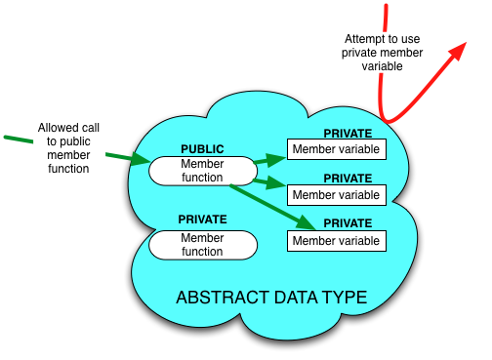
OOP for Abstraction
Designing for Abstraction in OOP:
Make all member variables private
Make the basic operations public and specify how to use them
Make any helping functions private
Notes:
What is abstraction?
You don’t need to know the mother’s name of your bus driver to catch the bus

